Slide 1


REST Assured API Testing with JAVA

Slide 2
Agenda
Tools Used
Automation Framework Architecture
Sample Report

Slide 3
Tools And Their Significance
REST Assured - Rest-Assured presents a great advantage because it supports multiple HTTP requests and can validate and/or verify the responses of these requests.
Core Java - There is an abundance of readily available frameworks, plugins, APIs and libraries that supports Java for test automation.
Maven(Build Tool) - Maven is a powerful project/ build management tool, which is based on the concept of a POM (Project Object Model) contains project information and configuration information for the maven to build the project like build directory, source directory, dependencies, test source directory, goals, plugin, etc.
Version control - System(Git/Bitbucket) & CI/CD(TeamCity)

Slide 4
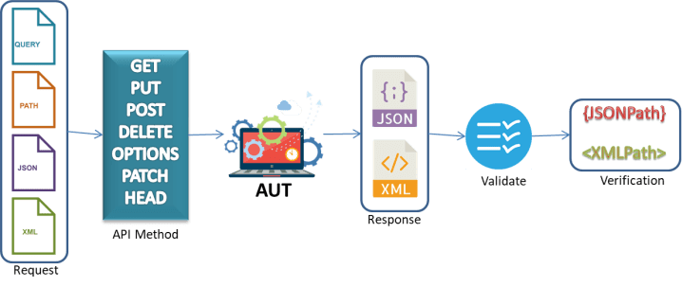
Framework Architecture

Slide 5
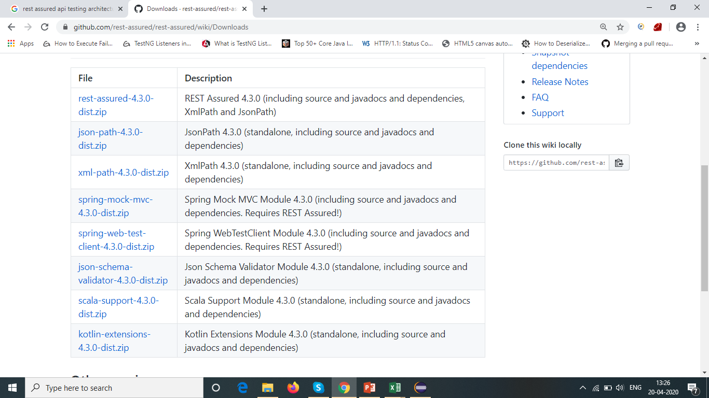

Slide 6
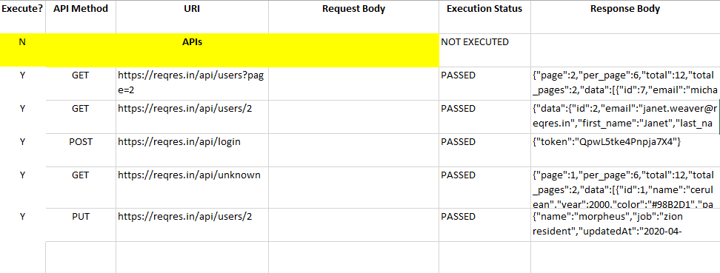
Reporting
Reporting

